Slide 1
CCNA (200-125)
Dynamic Routing
Instructor:
Muhammad Naeem
(MSIT/RHCE/CCNP/CCNA/MCSE)
Cell: 0345-5238281
E-Mail: mna571@yahoo.com

Slide 2
Lecture Overview:
Dynamic Routing
Types of Routing Protocols
Distance Vector Routing Protocols
Link State Routing Protocols
Hybrid Routing Protocols
Classification of Routing Protocol
Classful Routing Protocol
Classless Routing Protocol
RIP (Routing Information Protocol)

Slide 3
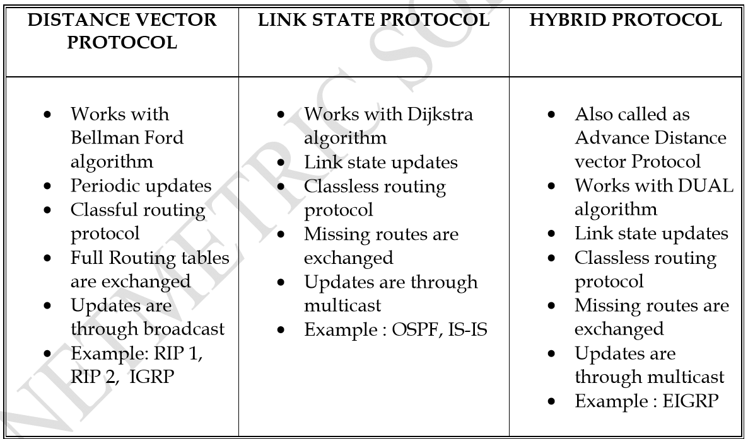
Types of Dynamic Routing Protocols

Slide 4
Types of Routing Protocols
Distance Vector Routing Protocols
Distance Vector Routing Protocols broadcast complete routing table, and sends periodic updates after every 30 seconds.
Examples; RIP, and IGRP
Link State Routing Protocols
Link State Routing Protocols don’t broadcast complete routing table, rather multicast it. And also don’t send periodic updates, instead send incremental updates, in case of any topology change.
Examples; OSPF,IS-IS

Slide 5
Classification of Routing Protocol
Classful Routing Protocol
Classful Routing protocols are those Routing Protocols that don’t carry subneting information with them, or which don’t support subnetting and VLSM
Classless Routing Protocol
Classless Routing protocols are those Routing Protocols that carry subneting information with them, or which support subnetting and VLSM
All distance vector protocols are classful except RIPv2

Slide 6
What is Distance Vector Routing Protocols
Distance vector routing protocols are those protocols that advertise routes as vectors of distance and direction.
Distance is defined in terms of a metric such as hop count and direction is simply the next-hop router or exit interface.
A router using a distance vector routing protocol does not have the full knowledge of the entire path to a destination network.
Instead the router knows only:
The direction or interface in which packets should be forwarded
The distance or how far it is to the destination network

Slide 7
Types of Distance Vector Routing Protocols
Distance vector routing protocols include:
RIP
IGRP
Routing Information Protocol (RIP):
Routing Information Protocol (RIP) was originally specified in RFC 1058. It has the following key characteristics:
Hop count is used as the metric for path selection.
If the hop count for a network is greater than 15, RIP cannot supply a route to that network.
Routing updates are broadcast or multicast every 30 seconds, by default.

Slide 8
Interior Gateway Routing Protocol (IGRP):
Interior Gateway Routing Protocol (IGRP) is a proprietary protocol developed by Cisco. IGRP has the following key design characteristics:
Bandwidth, delay, load and reliability are used to create a composite metric.
Routing updates are broadcast every 90 seconds, by default.
IGRP is the predecessor of EIGRP and is now obsolete.

Slide 9
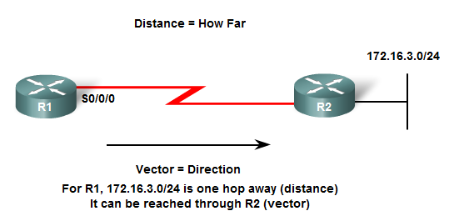

Slide 10
Common characteristics for DVR Protocols
Periodic Updates:
Updates are sent at regular intervals (30 seconds for RIP and 90 seconds for IGRP).
Even if the topology has not changed in several days, periodic updates continue to be sent to all neighbors.
Broadcast Updates:
Broadcast Updates are sent to 255.255.255.255.
Neighboring routers that are configured with the same routing protocol will process the updates.
All other devices will also process the update up to Layer 3 before discarding it.
Some distance vector routing protocols use multicast addresses instead of broadcast addresses.

Slide 11
Entire Routing Table Updates:
Entire Routing Table Updates are sent periodically to all neighbors.
Neighbors receiving these updates must process the entire update to find pertinent information and discard the rest.
Some distance vector routing protocols like EIGRP do not send periodic routing table updates.

Slide 12
What is Routing Algorithm?
An algorithm is a step by step procedure to accomplish some certain task
Different routing protocols use different algorithms
The algorithm used for the routing protocols defines the following processes:
Mechanism for sending and receiving routing information.
Mechanism for calculating the best paths and installing routes in the routing table.
Mechanism for detecting and reacting to topology changes.

Slide 13
Routing Protocols Characteristic:
Time to Convergence:
It defines how quickly the routers in the network topology share routing information and reach a state of consistent knowledge.
The faster the convergence, the more preferable the protocol.
Routing loops can occur when inconsistent routing tables are not updated due to slow convergence in a changing network
Scalability:
Scalability defines how large a network can become based on the routing protocol that is deployed.
The larger the network is, the more scalable the routing protocol needs to be.

Slide 14
Classless (Use of VLSM) or Classful:
Classless routing protocols include the subnet mask in the updates.
This feature supports the use of Variable Length Subnet Masking (VLSM) and better route summarization.
Classful routing protocols do not include the subnet mask and cannot support VLSM.
Resource Usage:
Resource usage includes the requirements of a routing protocol such as memory space, CPU utilization, and link bandwidth utilization.
Higher resource requirements can lead to more powerful hardware to support the routing protocol operation in addition to the packet forwarding processes.
Implementation and Maintenance:
Implementation and maintenance describes the level of knowledge that is required for a network administrator to implement and maintain the network based on the routing protocol deployed.

Slide 15
Advantages
Disadvantages
Because the level of knowledge require to implement & maintenance
Large amount of memory is not required, however, in larger network it can create problem
The use of periodic updates can cause slower convergence
Slow convergence may limit the size of the network, limited scalability
Routing loops can occur when inconsistent routing tables are not updated due to slow convergence

Slide 16
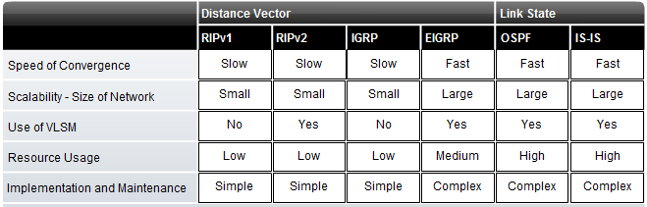

Slide 17
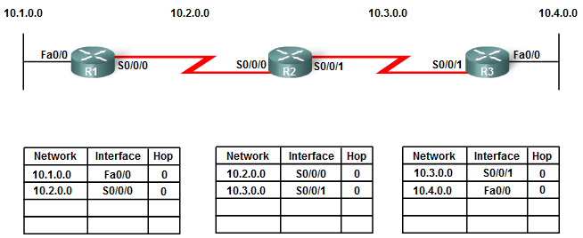
Network Discovery Process
When a router starts initially, it knows nothing about the network topology, if the IP addressing is configured correctly, then the router will initially discover its own directly connected networks. Directly connected interfaces have a distance of 0

Slide 18
If a routing protocol is configured, the routers begin exchanging routing updates. Initially, these updates only include information about their directly connected networks. Upon receiving an update, the router checks it for new information. Any routes that are not currently in its routing table are added.
Continuing the journey toward convergence, the routers exchange the next round of periodic updates. Each router again checks the updates for new information.

Slide 19
Convergence
Routers in the network topology share routing information and reach a state of consistent knowledge, where all routers have consistent information about the network, is called convergence
The amount of time it takes for a network to converge is directly proportional to the size of that network
The speed of achieving convergence consists of:
How quickly the routers propagates a change in the topology in a routing update to its neighbors.
The speed of calculating best path routes using the new routing information collected.
A network is not completely operable until it has converged, therefore, network administrators prefer routing protocols with shorter convergence times.

Slide 20
Routing Table Maintenance
Distance vector protocols send periodic updates to exchange routing information with their neighbors and to maintain up-to-date routing information in the routing table.
RIP and IGRP are examples of two such protocols.
Periodic updates refers to the fact that a router sends the complete routing table to its neighbors at a predefined interval.
RIP updates are sent every 30 seconds, while IGRP send the updates after 90 seconds whether or not there has been a topology change.

Slide 21
RIP (Routing Information Protocol)RIPv1
RIP Characteristics
A classful, Distance Vector (DV) routing protocol
Metric = hop count
Routes with a hop count > 15 are unreachable
Updates are broadcast every 30 seconds

Slide 22
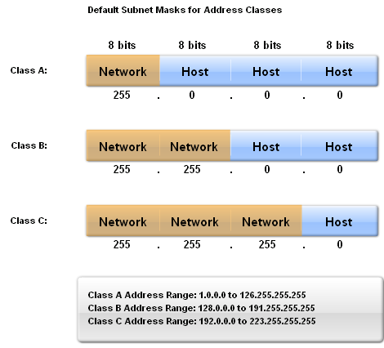
RIPv1
IP addresses initially divided into classes
Class A
Class B
Class C
RIP is a classful routing protocol
Does not send subnet masks in routing updates

Slide 23
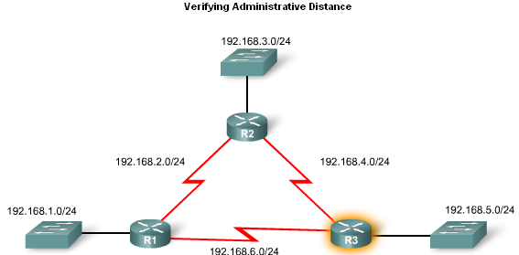
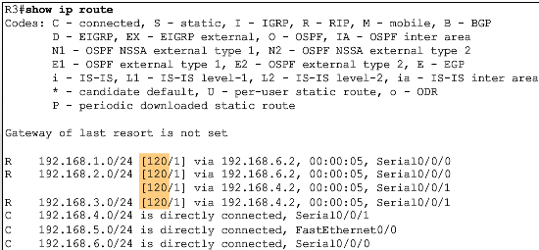
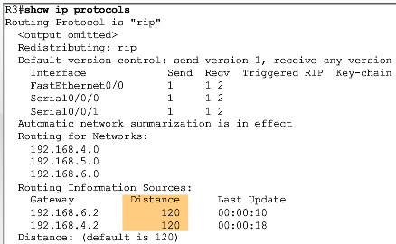
RIPv1
Administrative Distance
RIP’s default administrative distance is 120

Slide 24
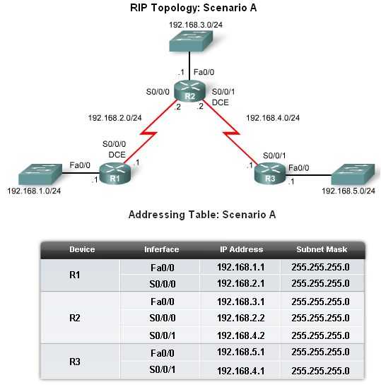
Basic RIPv1 Configuration
A typical topology suitable for use by RIPv1 includes:
Three router set up
No PCs attached to LANs
Use of 5 different IP subnets

Slide 25
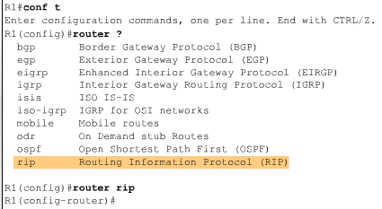
Basic RIPv1 Configuration
Router RIP Command
To enable RIP enter:
Router rip at the global configuration prompt
Prompt will look like R1(config-router)#

Slide 26
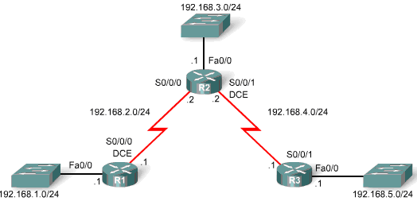
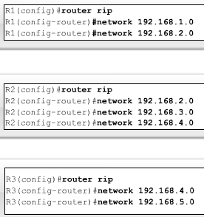
Basic RIPv1 Configuration
Specifying Networks
Use the network command to:
Enable RIP on all interfaces that belong to this network
Advertise this network in RIP updates sent to other routers every 30 seconds

Slide 27
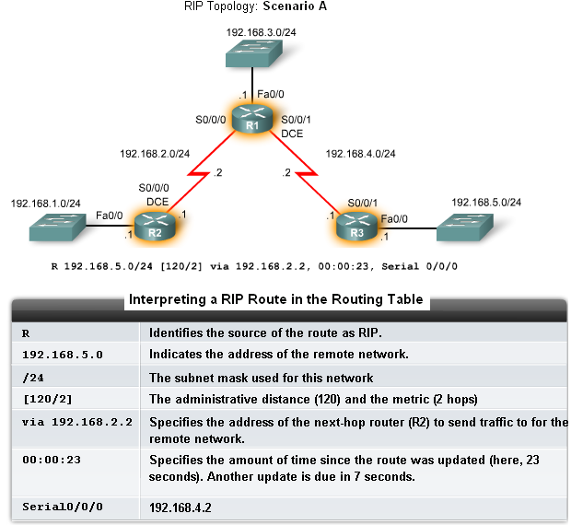
Verification and Troubleshooting
Show ip Route
To verify and troubleshoot routing
Use the following commands:
show ip route
show ip protocols
debug ip rip

Slide 28
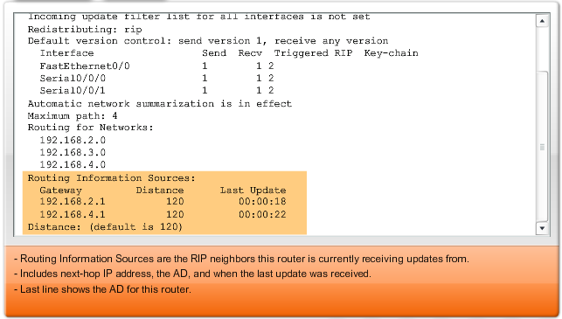
Verification and Troubleshooting
show ip protocols command
Displays routing protocol configured on router

Slide 29
RIP Versions
RIP Version 1:
By default RIP version 1 runs on Cisco Router. RIP Version 1 is Distance vector, classful routing protocol .
RIP Version 2:
RIP Version 2 manually we can enable on Cisco router.
RIP Version 2 is Distance Vector classless Routing Protocol.
Supports VLSM.
Use multicast address 224.0.0.9
RIP V1 can send and receive information to RIP V1 but can receive from RIP V2 and can’t send to RIP V2.

Slide 30
Note:
Administrative Distance:
[120/1, 120/2, 120/3]
Trustworthiness of Routing Protocols, whose dministrative distance value is less than all of other routing protocols that is to be trusted. e,g, RIP = 120 and IGRP=100 if both protocols are running the IGRP will be trustworthy, and runs on router.
Metric:
The criteria on which protocols select the path. RIP metric is hop count. If hop count is same from all possible sides then half trafic is sent from one side and half from other side, its called load balancing. If a link (any side) is down automatically alternative path is selected

Slide 31
Summary
RIP characteristics include:
Classful, distance vector routing protocol
Administrative distance is 120
Metric is Hop Count
Max Hop count=15 Max Routers=16
Used for small organizations
Does not support VLSM
Updates entire routing table every 30 seconds
Load Balancing of 4 equal paths

Slide 32
Summary: Commands used by RIP
Configuring RIP 1 :
Router(config)# router rip
Router(config-router)# network <Network ID>
Configuring RIP 2 :
Router(config)# router rip
Router(config-router)# network <Network ID>
Router(config-router)# version 2
Router(config-router)# no auto-summary

